Slide 1


Prediction of
LOGO
online shoppers’
purchasing intention
BT5151 Advanced Analytics and Machine Learning
Assignment 2
Group 9:
Chen Hong / A0231993X
Ma Ke / A0212524U
Yao Chuhan / A0231918A
Shichao Zhang / A0232016X
Nanhai Zhong / A0231953E
01

Slide 2
”
1. Background
2. Preprocessing & EDA
3. Feature Selection
4. Model - Decision Tree & SVM
5. Model - XGBoost
6. Model - MLP
7. Performance Comparison
Agenda
02

Slide 3
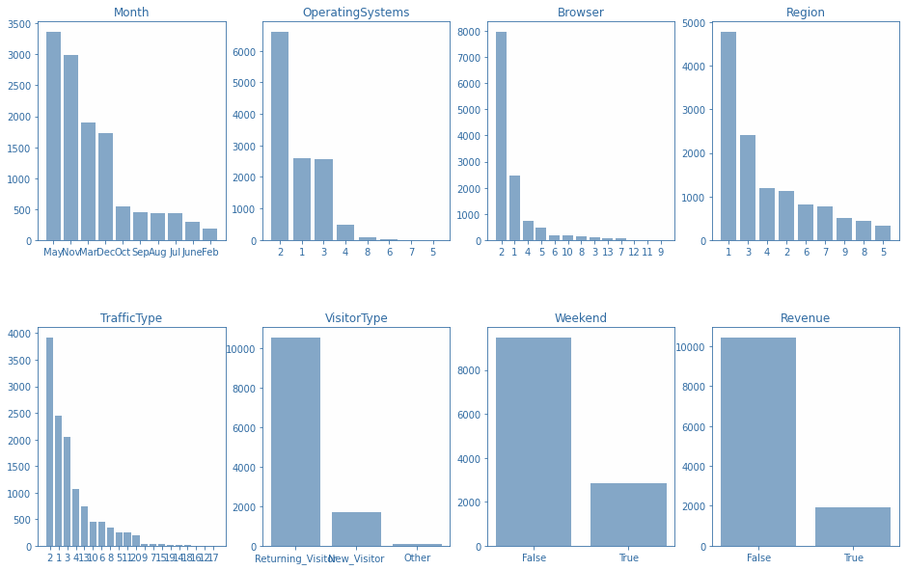
Introduction
Categorical Features Distribution
Background
E-commerce is thriving for decades. Many e-commerce companies analyse visitor sessions on their platforms, predicting user behavior with the aim of increasing purchase conversion rates.
Dataset
The dataset consists of 12,330 sessions. Each session was taken from a different user within a 1-year period.
Imbalanced dataset - resample
17 original features and 7 created features.
No missing values
Target
Objective
The task in the online shopper’s intention dataset is to predict whether a user is going to make a purchase based on data from a user’s current session.
03

Slide 4
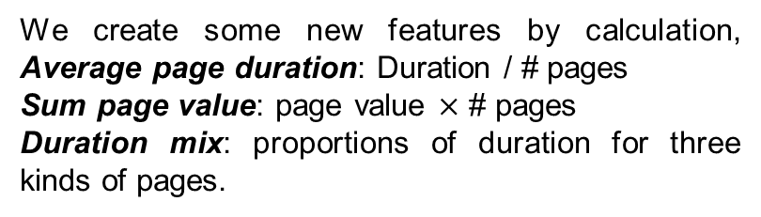
Preprocessing
Feature Creation
Train-test Split & Normalization
We create some new features by calculation, Average page duration: Duration / # pages
Sum page value: page value $×$ # pages
Duration mix: proportions of duration for three kinds of pages.
Test ratio : 0.3
Random state: 42
Normalized numeric features by Z-scaling.
Encoding & Missing data
Resampling
Binary encoding: 1 – True, 0 – False
Categorical encoding: Visitor Type, label encoding; Month, ordinal encoding
Check no missing data
Datasets that are highly skewed toward negative class. For model stability and optimal outcome, Two methods of resampling are applied for comparison.
Random over sampling (ROS)
Synthetic minority Over-Sampling Technique (SMOTE)

Slide 5
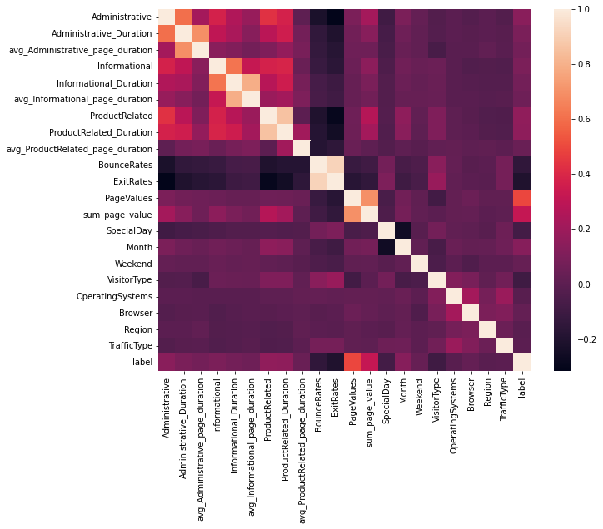
Features Correlation Analysis
Revenue
Page visits are highly correlated within the group
Page visits and duration for no matter what types are highly correlated. Except for average duration per page.
PageValue & Money-lose features are highly correlated with Revenue
BounceRates and ExitRates are negative correlated with pages features and the target, While PageValue has the most significant positive effect.
Money-lose features are negatively correlated with product related pages, which is reasonable.
Product related pages duration is much more than the others’, thus accounts more for the average exit rate.
04

Slide 6

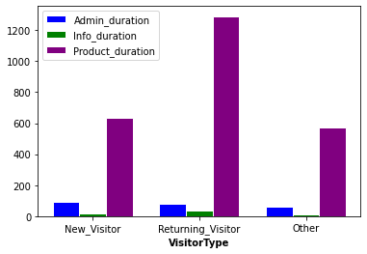
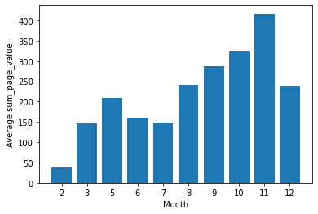
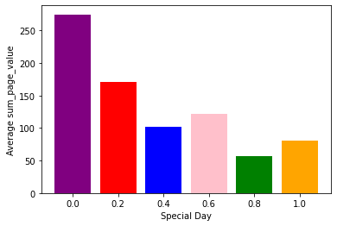
Insights & Findings
Duration among Visitor Types
Value against month
Sum of page value surprisingly become smaller when getting closer to special day
It can be explained by multiple value source on usual days. which also suggested that we should focus more on usual days.
Duration varies among VisitorType
New visitor spend more time on Admin pages than returned visitor. While, returned visitor is focus more on product related pages. The reason may be they are already familiar with admin.
Sum of page value fluctuate though year
We found that sum of value fluctuates a lot through different month. The second half of the year is the peak which raise to top on November.
Black Friday, …
Value against Special Day
05

Slide 7
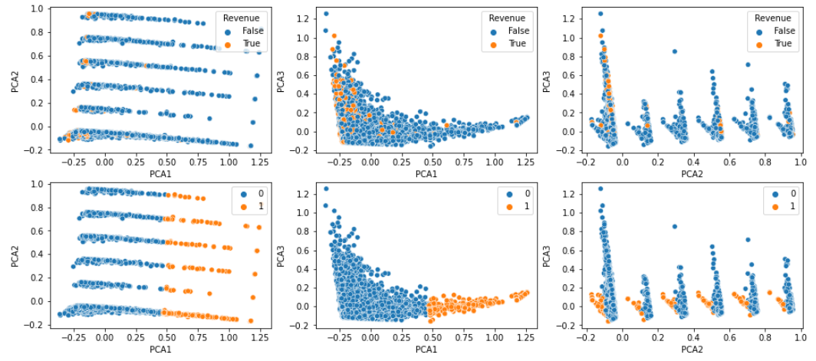
Visualizing distribution of class label in PCA and compare against clustering
Min-Max scaler on numerical features
Top row: plot true label on PCAS
Bottom row: plot k-means clustering based on numerical features on PCA
Since k-means is gobular, it is unable to capture the shape of the data, which is highly non-linear
06

Slide 8
Logistic regression (L1 penalization)
ML-based feature selection
L1 regularization makes coefficients of insignificant features go to zero. Pick the top 10 absolute coefficients.
Top-10-ranked features selected by 3 methods
Ranking | log-reg (L1) | PCA | Random forest
1 | Month_Feb | ProductRelated_Duration | PageValues
2 | PageValues | ProductRelated | ProductRelated_Duration
3 | OperatingSystems_8 | Administrative | ExitRates
4 | ExitRates | Informational | ProductRelated
5 | TrafficType_13 | ExitRates | Administrative_Duration
6 | Month_Mar | Administrative_Duration | BounceRates
7 | Month_Dec | BounceRates | Administrative
8 | Browser_12 | Informational_Duration | Informational_Duration
9 | Month_May | SpecialDay | Month_Nov
10 | Browser_3 | PageValues | Informational
PCA
Dimensionality reduction to pick top 3 vectors (PCA1, PCA2, PCA3) which are linear combination of all features which result in highest variance in data. Feature importance based on weighted variance. #7 and #9 are from PCA2 and PCA3.
Random forest
Random forest is an ensemble of decision tree which selects random feature for each decision split. The importance of a feature can be uncovered by measuring the mean decrease of impurity at each split of the tree associated with that feature.
Page Values and Exit Rates are common important features across all 3 methods.
07
Notes:
this ranking is based on original (no SMOTE no oversampling). PCA is based on absolute weighted variance of all 3 PCAs. exit rate and bounce rate comes from PCA2, the rest all PCA1.

Slide 9
Correlation
Filter-based feature selection
Choose features with the highest correlation coefficient with target variable (Revenue).
Top-10-ranked features selected by 3 methods
Mutual Information
Ranking | Correlation | Mutual Information | mRMR
1 | PageValues | PageValues | PageValues
2 | ExitRates | ExitRates | Month_Nov
3 | Month_Nov | ProductRelated_Duration | ExitRates
4 | BounceRates | ProductRelated | ProductRelated_Duration
5 | ProductRelated_Duration | BounceRates | OperatingSystems_3
6 | ProductRelated | Administrative_Duration | VisitorType_New_Visitor
7 | Administrative | Administrative | Administrative
8 | VisitorType_New_Visitor | VisitorType_Returning_Visitor | SpecialDay
9 | VisitorType_Returning_Visitor | TrafficType_2 | BounceRates
10 | TrafficType_2 | Month_Nov | ProductRelated
MI is a measure of mutual dependence of the two variables. While correlation coefficient can only capture linear relations, MI can also capture nonlinear relations.
mRMR
In mRMR algorithm, the aim is to maximize the relevance between the selected set of features and class variable while avoiding the redundancy among the selected features.
Page Values and Exit Rates are selected in the top 3 places by all filters and carries discriminative information about the intent of visitor.
Bounce Rates is also highly correlated with the class variable. However, since Bounce Rate is also highly correlated with Exit Rate and so contains redundant information, mRMR chooses it in the 9th order.
08
Notes:
In PCA, the features in the reduced space will be the linear combinations of all attributes, which brings the need of tracking all features during the visit and updating the feature vector after a new action is taken by the visitor.
Therefore, it has been deemed appropriate to apply feature selection instead of feature extraction within the scope of this study.
Considering the real-time usage of the proposed system, achieving better or similar classification performance with less number of features will improve the scalability of the system since less number of features will be kept track during the session.

Slide 10
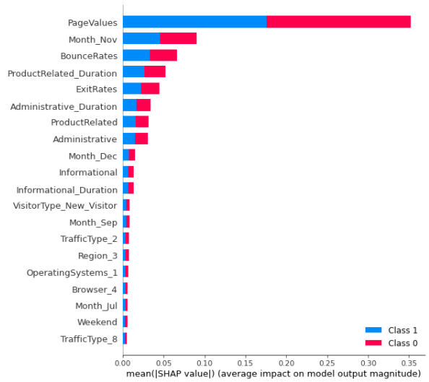
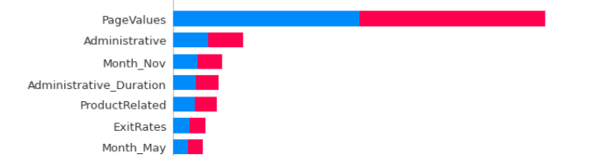
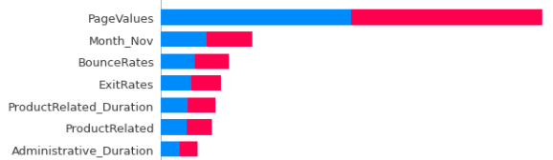
Important features:
PageValues, Month_Nov, ExitRates, Administrative_Duration, ProductRelated
Basic Model – Decision Tree
Basic models using all the features as input
Without oversampling
Scoring: TPR
Hyperparameters
Criterion =‘gini’
max_dept = 300
Accuracy:
Test Accuracy: 0.86
Test TPR: 0.54
Test TNR: 0.91
Test F1 Score: 0.54
SMOTE oversampling
Scoring: TPR
Hyperparameters
Criterion =‘entropy’
max_dept = 300
Accuracy:
Test Accuracy: 0.85
Test TPR: 0.64
Test TNR: 0.89
Test F1 Score: 0.58
ROS oversampling
Scoring: TPR
Hyperparameters
Criterion =‘entropy’
max_dept = 50
Accuracy:
Test Accuracy: 0.86
Test TPR: 0.54
Test TNR: 0.92
Test F1 Score: 0.54
09

Slide 11
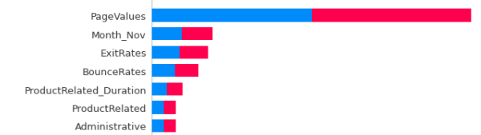
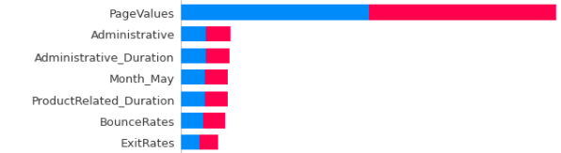
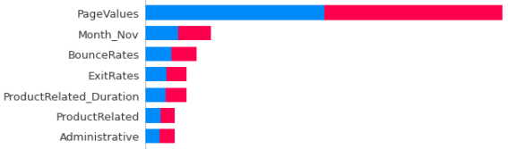
Important features:
PageValues, Month_Nov, ExitRates, Administrative, ProductRelated_Duration, BounceRates,
Basic Model – Random Forest
Basic models using all the features as input
Without oversampling
Scoring: TPR
Hyperparameters
n_estimators = 20
criterion =‘entropy’ min_samples_leaf = 2
Accuracy:
Test Accuracy: 0.89
Test TPR: 0.51
Test TNR: 0.94
Test F1 Score: 0.60
SMOTE oversampling
Scoring: TPR
Hyperparameters
n_estimators = 20
criterion =‘entropy’ min_samples_leaf = 2
Accuracy:
Test Accuracy: 0.89
Test TPR: 0.76
Test TNR: 0.91
Test F1 Score: 0.68
ROS oversampling
Scoring: TPR
Hyperparameters
n_estimators = 20
criterion =‘entropy’ min_samples_leaf = 2
Accuracy:
Test Accuracy: 0.89
Test TPR: 0.70
Test TNR: 0.92
Test F1 Score: 0.66
10

Slide 12
Basic Model – SVM
Basic models using all the features as input
RBF - Without oversampling
Linear - Without oversampling
Scoring: TPR
Kernel: RBF
Hyperparameters
C = 300
Accuracy:
Test Accuracy: 0.85
Test TPR: 0.51
Test TNR: 0.92
Test F1 Score: 0.52
Scoring: TPR
Kernel: Linear
Hyperparameters
C = 100
Accuracy:
Test Accuracy: 0.87
Test TPR: 0.55
Test TNR: 0.93
Test F1 Score: 0.57
RBF - SMOTE oversampling
Linear - SMOTE oversampling
Scoring: TPR
Kernel: RBF
Hyperparameters
C = 500
Accuracy:
Test Accuracy: 0.85
Test TPR: 0.52
Test TNR: 0.91
Test F1 Score: 0.52
Scoring: TPR
Kernel: Linear
Hyperparameters
C = 300
Accuracy:
Test Accuracy: 0.86
Test TPR: 0.53
Test TNR: 0.92
Test F1 Score: 0.54
RBF - ROS oversampling
Linear - ROS oversampling
Scoring: TPR
Kernel: RBF
Hyperparameters
C = 500
Accuracy:
Test Accuracy: 0.84
Test TPR: 0.52
Test TNR: 0.90
Test F1 Score: 0.51
Scoring: TPR
Kernel: Linear
Hyperparameters
C = 100
Accuracy:
Test Accuracy: 0.85
Test TPR: 0.56
Test TNR: 0.90
Test F1 Score: 0.54
11

Slide 13
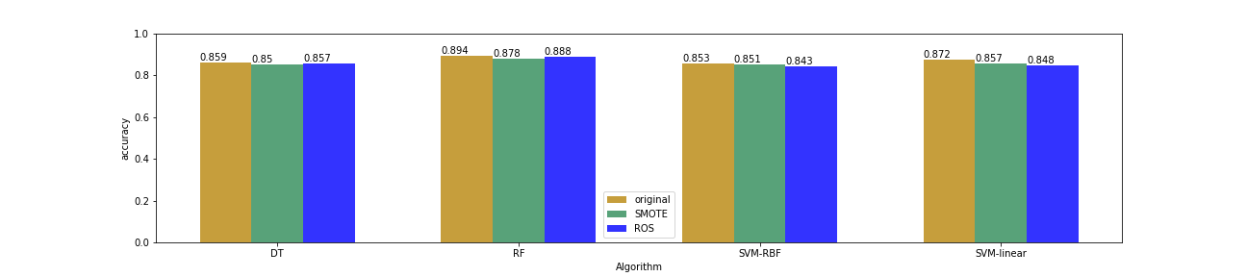
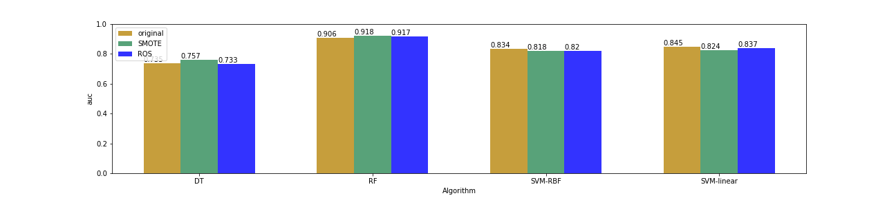
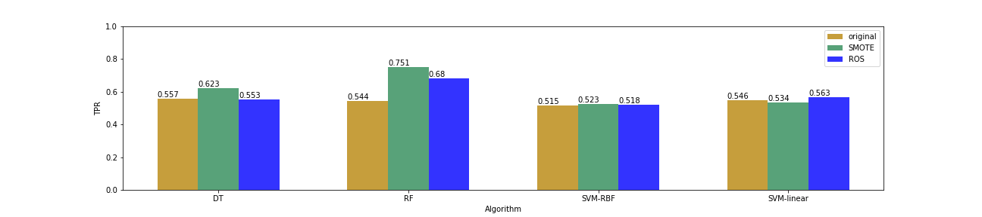
Basic Models – Performance Comparison
Insight：
Random Forest is better compared with other basic models.
The performance of SMOTE and ROS depends on the choice of models.
When it comes to TPR, RF+SMOTE have the best performance.
12

Slide 14
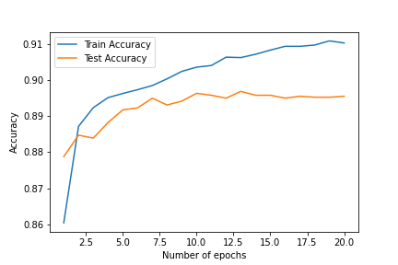
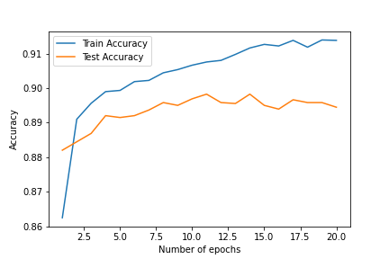
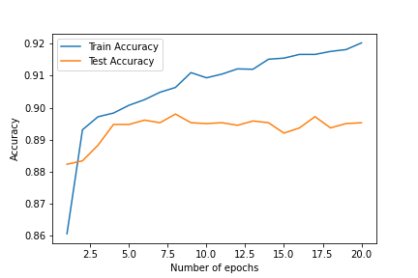
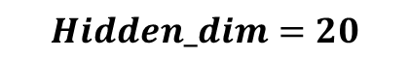
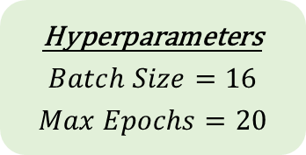
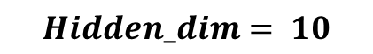
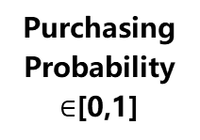
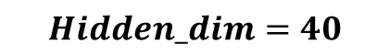
Multilayer perceptron (MLP) – without oversampling
MLP with different numbers of neurons in hidden layer
Epoch 13
Test Accuracy: 0.8969
Test TPR: 0.6010*
Test TNR: 0.9513
Test F1 Score: 0.6443*
Hyperparameters
$$Batch Size=16$$
$$Max Epochs=20$$
Model Structure
Input layer
$$Hidden_dim⁡= 10$$
Hidden Layer
Best Results
Epoch 14
Test Accuracy: 0.8983*
Test TPR: 0.5774
Test TNR: 0.9574
Test F1 Score: 0.6385
Output Layer
74
features
…
$$Hidden_dim⁡=20$$
…
Epoch 8
Test Accuracy: 0.8980
Test TPR: 0.5443
Test TNR: 0.9632*
Test F1 Score: 0.6241
Purchasing
Probability
$∈$[0,1]
10/20/40
neurons
$$Hidden_dim⁡=40$$
13

Slide 15
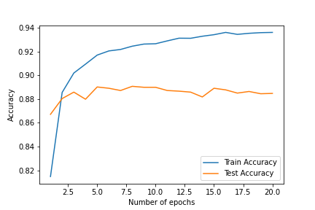
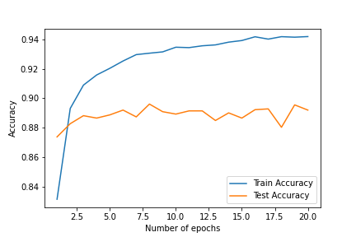

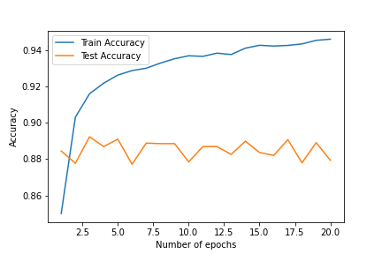
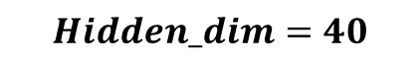
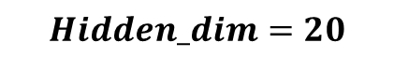
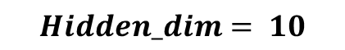
Multilayer perceptron (MLP) – with SMOTE oversampling
MLP with different numbers of neurons in hidden layer
MLP without Oversampling
Epoch 8
Test Accuracy: 0.8907
Test TPR: 0.6475*
Test TNR: 0.9353
Test F1 Score: 0.6475
Hidden Dim | Best Epoch | Test Acc | Test TPR | Test TNR | Test F1 Score
10 | 13 | 0.90 | 0.60 | 0.95 | 0.64
20 | 14 | 0.90 | 0.58 | 0.96 | 0.64
40 | 8 | 0.90 | 0.54 | 0.96 | 0.62
$$Hidden_dim⁡= 10$$
Best Results
Epoch 8
Test Accuracy: 0.8961*
Test TPR: 0.6243
Test TNR: 0.9462
Test F1 Score: 0.6515*
Better TPR and F1 Score
Faster training
$$Hidden_dim⁡=20$$
Hidden Dim | Best Epoch | Test Acc | Test TPR | Test TNR | Test F1 Score
10 | 8 | 0.89 | 0.65 | 0.94 | 0.65
20 | 8 | 0.90 | 0.62 | 0.95 | 0.65
40 | 3 | 0.89 | 0.58 | 0.95 | 0.63
Epoch 3
Test Accuracy: 0.8923
Test TPR: 0.5801
Test TNR: 0.9497*
Test F1 Score: 0.6259
MLP with SMOTE Oversampling
$$Hidden_dim⁡=40$$
14

Slide 16
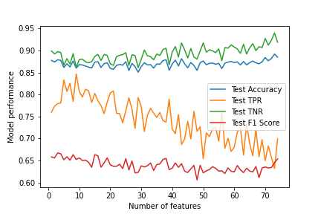
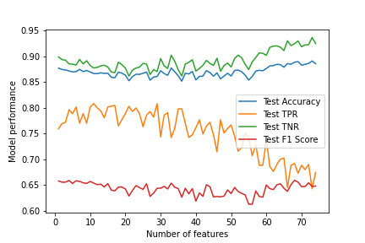
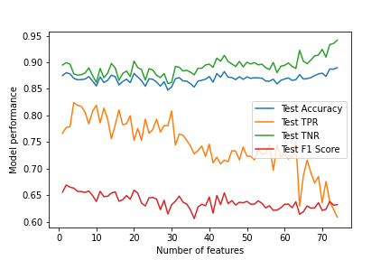
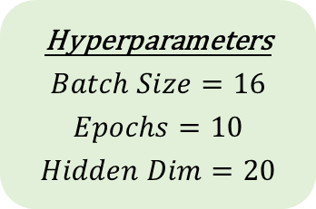
Multilayer perceptron (MLP)
Number of features: 73
Test Accuracy: 0.8912
Test TPR: 0.6429
Test TNR: 0.9369
Test F1 Score: 0.6474
Correlation
MLP using top K ranked features as input
Hyperparameters
$$Batch Size=16$$
$$Epochs=10$$
$$Hidden Dim=20$$
Number of features: 73
Test Accuracy: 0.8920
Test TPR: 0.6318
Test TNR: 0.9398
Test F1 Score: 0.6447
Top 10 ranked features are sufficient to gain high True Positive Rate!!!
mRMR
Number of features: 74
Test Accuracy: 0.8899
Test TPR: 0.6087
Test TNR: 0.9417
Test F1 Score: 0.6323
Mutual Information
15

Slide 17
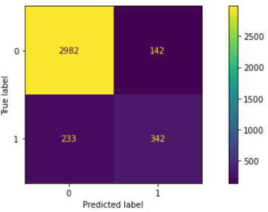
XGBoost
Performance without oversampling
Scoring: AUC
Hyperparameters
learning_rate =0.01,
n_estimators=1000,
max_depth=3,
min_child_weight=3,
gamma=0.2,
subsample=0.95,
colsample_bytree=0.75,
reg_alpha=1,
eval_metric='auc',
nthread=4,
scale_pos_weight=1,
seed=27
Tuning with cv_folds=5
Observations:
max_depth is not high, reg_alpha is high: The model relies on few important features
Accuracy = 89.86% , AUC = 93.20%, TPR = 59.48%
16

Slide 18
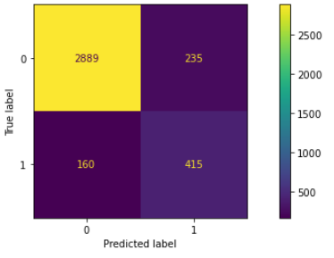
XGBoost
Same hyperparameters but higher scale_pos_weight
Scoring: AUC
Hyperparameters
learning_rate =0.01,
n_estimators=1000,
max_depth=3,
min_child_weight=3,
gamma=0.2,
subsample=0.95,
colsample_bytree=0.75,
reg_alpha=1,
eval_metric='auc',
nthread=4,
scale_pos_weight=2,
seed=27
Observations:
Similar AUC but higher TPR
Accuracy = 89.32% , AUC = 93.23%, TPR = 72.17%
17

Slide 19
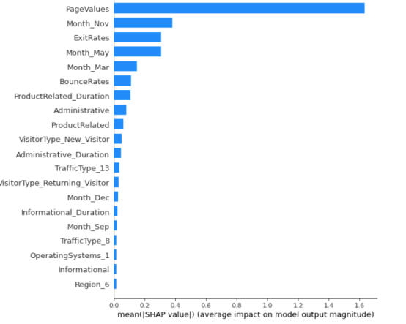
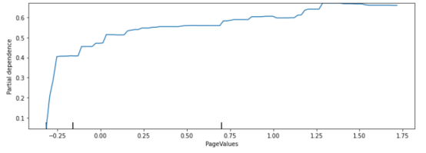
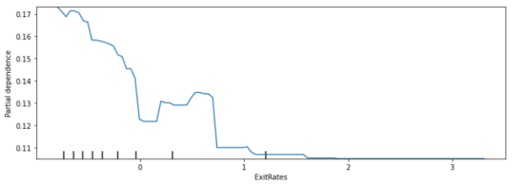
XGBoost
Using SHAP and Partial Dependence to explain feature importance and correlation
Higher the PageValue, the more likely to buy
Lower the ExitRates, the more likely to buy
18

Slide 20
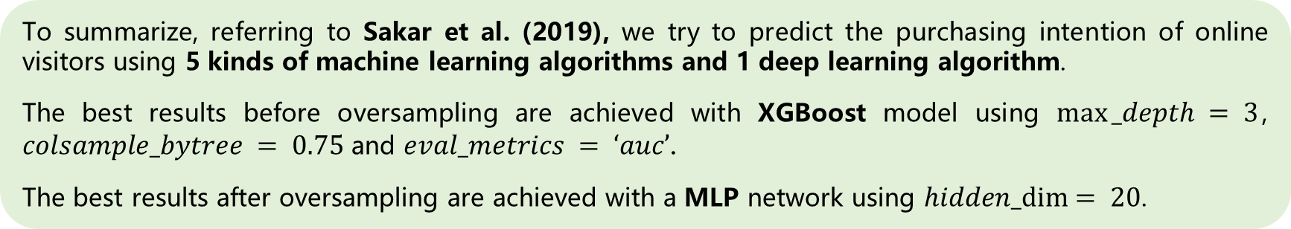
Performance Comparison
 | Before Oversampling |  |  | After Oversampling
 | Accuracy | TPR | AUC | Accuracy | TPR | AUC
Decision Tree | 0.859 | 0.557 | 0.735 | 0.857 | 0.623 | 0.757
Random Forest | 0.894 | 0.544 | 0.906 | 0.888 | 0.751* | 0.918
SVM - RBF | 0.853 | 0.515 | 0..834 | 0.851 | 0.523 | 0.820
SVM - Linear | 0.872 | 0.546 | 0.845 | 0.857 | 0.563 | 0.837
XGBoost | 0.899* | 0.595* | 0.932* | 0.893 | 0.722 | 0.932*
MLP | 0.898 | 0.577 | 0.916 | 0.896* | 0.624 | 0.904
To summarize, referring to Sakar et al. (2019), we try to predict the purchasing intention of online visitors using 5 kinds of machine learning algorithms and 1 deep learning algorithm.
The best results before oversampling are achieved with XGBoost model using $max⁡_depth = 3$, $colsample_bytree = 0.75$ and $eval_metrics = ‘auc’$.
The best results after oversampling are achieved with a MLP network using $hidden_dim⁡= 20$.
19
Notes:
In this project, we try to predict the purchasing intention of online visitors using methods mentioned in Sakar et al. (2019).
We use aggregated pageview data kept track during the visit along with some session and user information as input to machine learning algorithms.
We apply oversampling and feature selection preprocessing techniques to improve the success rates and scalability of the algorithms.
The best results before oversampling are achieved with XGBoost model using max_depth = 3 and eval_metrics = ‘auc’.
The best results after oversampling are achieved with a multilayer perceptron network using hidden_dim = 20.

Slide 21
LOGO
Thank you!
By Group 9
20

